Slide 1
Domestic Violence & the Workplace

Slide 2
Content Warning
This course will include discussion around topics such as sexual assault, domestic violence, stalking, and physical violence. This content may be especially difficult for those who have survived domestic violence or assault.
If at any time during this training you experience a trigger and feel unable to cope with it, please reach out to Employee Assistance Program at (505)768-4613 for support.
If you are experiencing a crisis after- hours (between 5pm to 8am M-F or on weekends), you may call the Solutions Group Crisis Line at (505)254-3555.
If you are experiencing a life-threatening emergency please call 911 immediately.

Slide 3
Agenda
Domestic Violence Overview
Impacts of Domestic Violence on the workplace
Recognizing warning signs among employees
Responding to domestic violence in the workplace
Resources for Employers and Employees

Slide 4
domestic violence overview

Slide 5
What is Domestic Violence?
Definitions of Domestic Violence:
Domestic violence is a pattern of abusive behavior in any relationship that is used by one partner to gain or maintain power and control over another intimate partner (U.S. Dept. of Justice).
Domestic violence is the willful intimidation, physical assault, battery, sexual assault, and/or other abusive behavior as part of a systematic pattern of power and control perpetrated by one intimate partner against another. It includes physical violence, sexual violence, psychological violence, and emotional abuse. The frequency and severity of domestic violence can vary dramatically; however, the one constant component of domestic violence is one partner’s consistent efforts to maintain power and control over the other (NCADV).

Slide 6
Types of abuse
Physical: This is type of abuse may include punching, hitting, slapping, kicking, strangling, physically restraining a partner against their will, driving recklessly, invading physical space, or any other form that makes someone feel physically unsafe.
Sexual: This type of abuse may involve rape or other forced sexual acts, or withholding or using sex as a weapon.
Verbal or Emotional: This type of abuse may involve yelling at or insulting a partner, rejection and belittling, and/or gaslighting, which includes making the partner doubt their feelings, thoughts, or sanity, and by manipulating the truth.

Slide 7
Types of abuse cont’d
Mental/Psychological: This type of abuse may involve the regular and deliberate use of words and non-physical actions in order to try and manipulate, hurt, weaken, or frighten a partner; and/or to confuse or influence the partner’s thoughts and actions, which affects their sense of self and harms their wellbeing.
Financial: This type of abuse may involve an abuser who controls all of the finances, not letting the partner have access to their own bank accounts or spending money, opening credit cards and running up debts in their partner’s name, or not allowing their partner to have a job and earn their own money.
Cultural/Identity: This type of abuse involves the use of aspects of a partner’s particular cultural identity to inflict suffering, or as a means of control. This can look like not allowing someone observe the dietary or dress customs of their faith, using racial slurs, threatening to ‘out’ someone as LGBQ/T if their friends and family don’t know, or isolating someone who doesn’t speak the dominant language where they live.

Slide 8
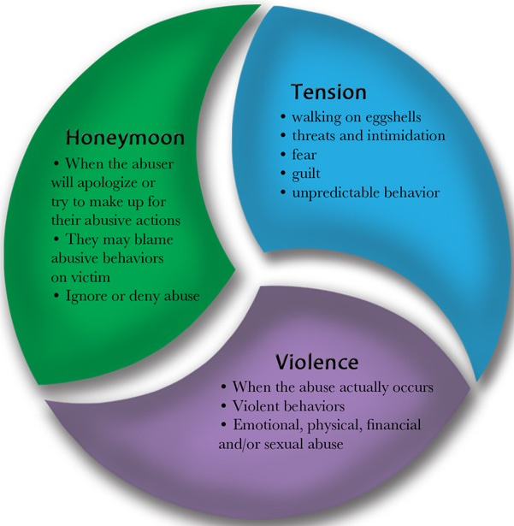
THE Domestic Violence CYCLE
PHASES:
Honeymoon Phase: During this phase the relationship is relatively calm and peaceful. The abuser may agree to engage in counseling, ask for forgiveness, and try to create a normal atmosphere.
Tension Phase: During this phase the abuser begins to assert their power over their partner in an attempt to control their partner's actions.
Violent Phase: During this phase the abuser attempts to dominate their partner. Outbursts of violence and abuse occur which may include physical, verbal, sexual, and/or psychological abuse.

Slide 9
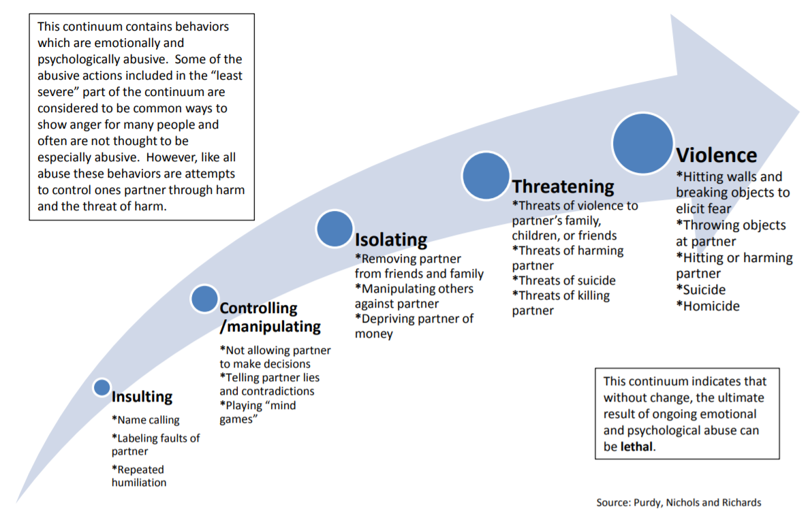
THE Domestic Violence continuum

Slide 10
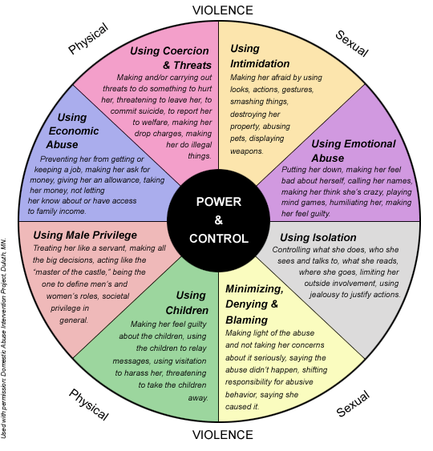
Why Don’t People Just LEAVE?

Slide 11
The impact of Domestic Violence in the workplace

Slide 12
Domestic Violence statistics
One in four women and one in seven men will experience domestic violence in their lifetime (CDC).
On average, nearly 20 people per minute are physically abused by an intimate partner in the United States (NCADV).
Women between the ages of 18-24 are most commonly abused by an intimate partner (NCADV).
Being a survivor of domestic violence is correlated with a higher rate of depression and suicidal behavior (NCADV).

Slide 13
impacts on employee Safety & productivity
Survivors of intimate partner violence lose a total of 8 million days of paid work each year (NCADV).
Between 21-60% of survivors of intimate partner violence lose their jobs due to reasons stemming from the abuse (NCADV).
A 2013 analysis found that women who have experienced intimate partner violence were almost twice as likely to experience depression and problem drinking (WHO).

Slide 14
Impacts on overall workplace safety
Between 2003 and 2008, 142 women were murdered in their workplace by their abuser, which was 78% of women killed in the workplace during this timeframe (NCADV).
Most survivors report that domestic violence negatively affects their work performance (Wathen et al, 2015).
Many survivors also report that their coworkers experience harassment, or even threats from the perpetrator (Wathen et al, 2015).

Slide 15
The cost of Domestic Violence in the Workplace
The lifetime economic cost associated with medical services for domestic violence-related injuries, lost productivity from paid work, criminal justice and other costs, is $3.6 trillion (CDC).
The average cost of domestic over a survivor’s lifetime was $103,767 for women and $23,414 for men (CDC).
In one case, a wrongful death action against an employer who failed to respond to an employee’s risk of domestic violence on the job cost the employer $850,000 (Burke, 2000).
Employers are aware of these costs: 44% of executives surveyed say that domestic violence increases their health care costs (Futures without Violence).

Slide 16
Recognizing Domestic Violence in the workplace

Slide 17
General Indicators
Physical injuries
Excuses for frequent injuries
Anxiety and/or depression
Missing work and social occasions
Nervousness/easily startled
Low self-esteem
Lack of independent communication
Self-blame
Increased alcohol or drug use
Lack of money
Damage to property

Slide 18
Indicators of domestic violence in the workplace
Arriving to work very late or very early
Taking time off without notice
Decreased productivity
Tension around receiving personal phone calls
Wearing long sleeves on a hot day or wearing sunglasses inside
Difficulty in making decisions or concentrating
Avoiding windows, main entrance to the office

Slide 19
Indicators of domestic violence in the workplace cont’d
Repeated discussion of marital or relationship problems
Flowers or gifts sent to employee at the workplace for no apparent reason
Bruises, chronic headaches, abdominal pains, muscle aches
Taking frequent time off for “illnesses” or to see the doctor
Fatigue
Intense startle reactions

Slide 20
Responding to Domestic Violence in the workplace

Slide 21
CABQ Policies and Procedures
AI NO: 7-22: VIOLENCE IN THE WORKPLACE AND DOMESTIC VIOLENCE POLICIES
B. Violence in the Workplace Policy
It is the policy of the City of Albuquerque that workplace violence by employees shall be prohibited. Furthermore, violent behavior including domestic disputes directed toward a City employee by a member of the general public shall not be tolerated.
Prohibited workplace behavior includes intimidation; verbal threats; physical assault; vandalism; arson; sabotage; the unauthorized display, possession or use of weapons on City property (Personnel Rules/Regulations 301.7), jokes or comments regarding violent acts which are reasonably perceived to be a threat; or any other behavior reasonably perceived to be a threat of imminent harm against an employee or member of the general public.
It is the responsibility of all employees who witness or are the subject of the behaviors prohibited by this policy to report the incident(s) to their immediate supervisor unless the supervisor is the one exhibiting the prohibited behavior, in which case the employee shall report the behavior to the next highest person within the organization.

Slide 22
CABQ Policies and Procedures
AI NO: 7-22: VIOLENCE IN THE WORKPLACE AND DOMESTIC VIOLENCE POLICIES
B. Violence in the Workplace Policy Cont’d
It is the responsibility of the supervisor receiving the complaint to conduct an investigation of the incidents(s) in accordance with the methods and procedures presented in the mandated supervisory development training. These materials may be obtained from Employee Health Services, 768-4613. The supervisor will initiate appropriate action to abate the prohibited behavior. The supervisor shall prepare a written response within 10 days to the employees(s) reporting the incident(s). This response shall include acknowledgement of the employee(‘s) complaint; that an appropriate investigation is being or has been conducted; and, the action that was initiated to abate the prohibited behavior.
After a finding of fact that an employee engaged in prohibited behavior, a pre-determination hearing will be conducted and the hearing officer will make a mandatory referral to the Employee Assistance Program (768-4613) and recommend disciplinary action. The applicable department director will determine the level of discipline up to and including termination.

Slide 23
CABQ Policies and Procedures
AI NO: 7-22: VIOLENCE IN THE WORKPLACE AND DOMESTIC VIOLENCE POLICIES
D. Domestic Violence/Civil Protection Orders
It is the intent of this policy to encourage employees to self-disclose situations relating to domestic violence. Employees shall notify their supervisors the workplace may be in danger from the perpetrator. Employees shall notify their supervisor and the Employee Health Services Manager when the City worksite has been included (or is requested to be included) in a civil protection order and to provide a copy of the civil protection order to their supervisor.
Supervisors have the responsibility to take reasonable steps to honor the civil protection order and to expedite a request for leave of absence, if necessary. Supervisors shall contact the City's Employee Assistance Program to facilitate contact between the Program and impacted employee. Supervisors shall maintain respect for individual privacy and confidentiality within the context of protecting the worksite, co-workers, general public and the individual employee involved.

Slide 24
Increasing awareness and providing support
In order to respond appropriately to domestic violence issues and create a safe workplace, managers, supervisors, and employees should:
Start the Conversation – don’t be afraid to talk about the issue
Build Awareness among employees through training and regular conversations
Become familiar with the City’s Policies and Procedures regarding Domestic Violence and Violence in the Workplace
Remind folks to reach out to the Employee Assistance Program (EAP) should they need counseling services or assistance with an issue
Have a plan for how to respond should the issue arise

Slide 25
Implementing Safety Procedures for Domestic Violence
Employees with Orders of Protection should bring a copy to work and provide to appropriate staff
A picture of the abuser should be given to security and reception
Ensure that reasonable accommodations are provided to survivors
Ensure that the confidentiality of the survivor is strictly protected

Slide 26
Domestic abuse leave
From N.M. Stat. § 50-4A-5(A), N.M. Stat. § 50-4A-3
Domestic abuse leave is paid or unpaid leave that you can use to handle certain issues related to a domestic violence incident. Domestic abuse leave includes sick leave or any other type of available paid leave you have. For domestic abuse leave, an employee may use paid or unpaid leave for up to eight hours a day for 14 days. The 14 days can be taken in a row or spread out over the calendar year.
Domestic abuse leave can be used in the following circumstances:
to get an order of protection
To meet with law enforcement officers;
talk to a lawyer or a domestic violence advocate
attend a court hearing related to the domestic abuse for you or a family member

Slide 27
Resources for employees and managers

Slide 28
RESOURCES
SHELTERS AND ADVOCACY:
Valencia Shelter:
Los Lunas, 505‐864‐1383, www.valenciashelterservices.org
Valencia Shelter offers immediate shelter, individual advocacy, support groups, and specialized programs for children, including counseling and play‐therapy.
Languages Spoken: English, Spanish
Domestic Violence Resource Center:
Albuquerque, 575‐894‐3557, www.dvrcnm.org
Domestic Violence Resource Center (DVRC) offers individual advocacy and support, legal advocacy, individual counseling by licensed counselors, case management, and financial empowerment classes supported by Allstate (Insurance) Foundation. DVRC has advocates embedded at the District Attorney's Office and Second District Courts and provides critical education and community outreach programs.
Languages Spoken: English, Spanish

Slide 29
RESOURCES
SHELTERS AND ADVOCACY CONT’D:
Enlace Comunitario:
Albuquerque, 505‐246‐8972, www.enlacenm.org
Enlace Comunitario focuses on services and support for survivors in the Latino Immigrant Community. They offer individual support and advocacy, enhanced legal advocacy (with an attorney on staff), support groups, individual counseling with licensed counselors, access to transitional housing, and life‐skills classes for children and teens.
Languages Spoken: English, Spanish
SAFE House:
Albuquerque, 800‐773‐3645, www.safehousenm.org
SAFE House offers immediate shelter, individual advocacy, support groups, licensed counselors, transitional housing, and programs for children and teens.
Languages Spoken: English, Spanish

Slide 30
Resources
HOTLINES:
National Domestic Violence Hotline: (live chat available on website), 1-800-799-7233
National Teen Dating Abuse Helpline: (live chat available on website), 1-866-331-9474, or Text “loveis” to 22522
New Mexico Crisis and Access Line: 1-855-662-7474
LEGAL ASSISTANCE:
New Mexico Legal Aid Domestic Violence HelpLine: 1-877-974-3400
The New Mexico Legal Aid Domestic Violence, Sexual Assault, and Stalking HelpLine is a free statewide service that provides legal information, advice and referrals to attorneys and other community agencies who can help survivors.
www.lawhelpnewmexico.org: Provides information on domestic violence, orders of protections and resources for legal help from New Mexico Legal Aid.

Slide 31
RESOURCES for survivors
WEBSITES:
The New Mexico Coalition Against Domestic Violence: https://nmcadv.org/
National Resource Center on Domestic Violence: https://www.nrcdv.org/
City of Albuquerque Domestic Violence Webpage: https://www.cabq.gov/police/crime-prevention-safety/personal-safety/domestic-violence
CITY OF ALBUQUERQUE EMPLOYEE ASSISTANCE PROGRAM:
Hours: Monday-Friday from 8:00am to 5:00pm Phone: (505) 768-4613
Email: eap@cabq.gov
Emergency On-Call Phone (After Hours/Weekends): (505) 254-3555
*If you are experiencing a life-threatening emergency, please call 911

Slide 32
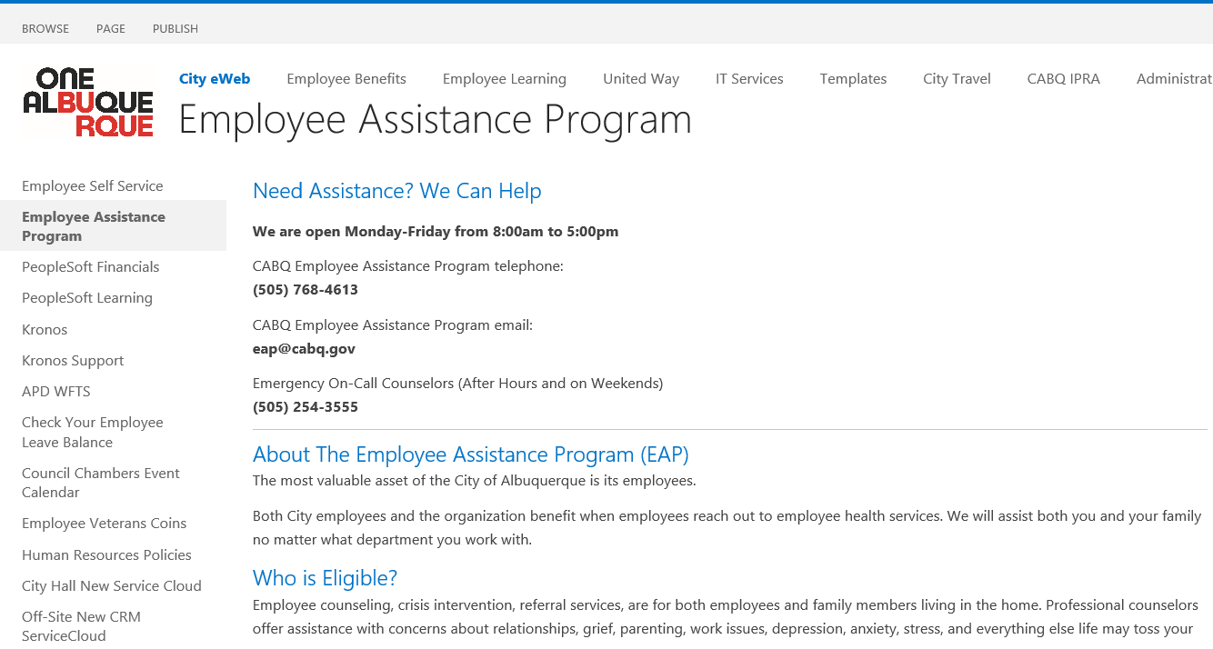
RESOURCES for survivors
A Copy of the slides from this presentation may be downloaded from the Employee Assistance Program Page at eweb.cabq.gov.

Slide 33
Interested in more training?
Contact Dr. Lindsey Campos, EAP Manager for the City of Albuquerque
Direct and Confidential Line: 505-768-4614
Email: lcampos@cabq.gov

Slide 34
References:
Burke, D.F. January, 2000. When employees are vulnerable, employers are too. The National Law Journal. Retrieved January 9, 2004. http://www.semmes.com/publications.
Centers for Disease Control and Prevention (2021). Intimate Partner Violence. Retrieved from https://www.cdc.gov/violenceprevention/intimatepartnerviolence/index.html
Futures without Violence (2021) The facts on the workplace and domestic violence. Retrieved from https://www.futureswithoutviolence.org/userfiles/file/Children_and_Families/Workplace.pdf
National Coalition Against Domestic Violence (2021). Statistics. Retrieved from https://ncadv.org/STATISTICS
REACH (2021). 6 different types of abuse. Retrieved from https://reachma.org/6-different-types-abuse/

Slide 35
References cont’d:
Wathen, C. N., MacGregor, J. C., & MacQuarrie, B. J. (2015). The Impact of Domestic Violence in the Workplace: Results From a Pan-Canadian Survey. Journal of occupational and environmental medicine, 57(7), e65–e71. https://doi.org/10.1097/JOM.0000000000000499
Womenslaw.org (2021) New Mexico Workplace Protections. Retrieved from https://www.womenslaw.org/laws/nm/workplace-protections/all
World Health Organization (2021). Violence Against Women. Retrieved from https://www.who.int/news-room/fact-sheets/detail/violence-against-women

